Slide 1
File I/O & Exception Handling
Brandon Krakowsky

Slide 2
File I/O

Slide 3
Why Java I/O is Difficult
Java I/O (Input/Output) is very powerful, with an overwhelming number of options
Any given kind of I/O is not particularly difficult
The difficulty is in finding your way through the maze of possibilities

Slide 4
Streams
All modern I/O is stream-based
A stream is a connection to a source of data or to a destination for data (sometimes both)
An input stream may be associated with the keyboard
An input stream or output stream may be associated with a file
Different streams have different characteristics:
A file has a definite length, and therefore an end
Keyboard input has no specific end

Slide 5
How to do I/O
import java.io.*;
Open the stream
Use the stream (read, write, or both)
Close the stream

Slide 6
Opening & Reading a File Method 1: FileReader & BufferedReader
You can use a FileReader to open (or connect to) a file for input
First, create a File object File myFile = new File(pathToFile);
Then create a FileReader with the given File object FileReader fileReader = new FileReader(myFile);
myFile specifies a File object. If it doesn’t exist, a FileNotFoundException is thrown. (More on this later in the lecture.)
Finally, create a BufferedReader, which takes a FileReader as an argument BufferedReader bufferedReader = new BufferedReader(fileReader);
A BufferedReader provides buffering of data (stored in memory) for fast and efficient reading
You can use a BufferedReader to read entire lines of data

Slide 7
Opening & Reading a File Method 1: FileReader & BufferedReader
To read a whole line with the BufferedReader, use the readLine method String s = bufferedReader.readLine();
readLine will return null if there is nothing more to read
If an I/O error occurs, an IOException is thrown. (More on this later in the lecture.)
You should always close the FileReader and BufferedReader fileReader.close(); bufferedReader.close();

Slide 8
Opening & Reading a File Method 2: Scanner
You can also use a Scanner to open (or connect to) a file for input
Again, first create a File object File myFile = new File(pathToFile);
Then create a Scanner with the given File object Scanner sc = new Scanner(myFile);
If the file isn’t found, a FileNotFoundException is thrown
You can read and parse one “token” (value) at a time sc.next(), sc.nextBoolean(), sc.nextInt(), sc.nextDouble(), etc.

Slide 9
Opening & Reading a File Method 2: Scanner
Before trying to get a value, it’s good to check if there actually is a value sc.hasNext(), sc.hasNextInt(), sc.hasNextDouble(), etc.
Here’s the logic: //check for another token to read if (sc.hasNext()) { //get next token String nextValueToRead = sc.next(); }
And you should always close the Scanner sc.close();

Slide 10
Opening & Reading a File Method 3: Files
For reference, java.nio.file.Files is a utility class that contains various useful file methods
The static readAllLines method reads all lines from a file, into a List of Strings File myFile = new File(pathToFile); List<String> allLines = Files.readAllLines(myFile.toPath());
This method puts everything into memory at once
It’s good for small files
But don't use it if your file is large -- it’s not very efficient
You can treat the List of Strings like an ArrayList //iterate over arraylist and print each line for (String line : allLines) { System.out.println(line); }

Slide 11
Opening & Reading a File Method 3: Files
For reference, java.nio.file.Files is a utility class that contains various useful file methods
The static lines method reads all lines from a file, as a Stream of Strings File myFile = new File(pathToFile); Stream<String> linesStream = Files.lines(myFile.toPath());
This method does not read all lines of a file at once
It reads lines of a file as a Stream, line by line, as needed (for operations)
Use this if your file is large – it’s more efficient
You can access (and perform an action for) each element of the stream linesStream.forEach(line -> { System.out.println(line); });

Slide 12
File Writing Method 1: FileWriter & PrintWriter
Create a FileWriter object FileWriter fw = new FileWriter(new File(pathToFile), append);
If an I/O error occurs, an IOException is thrown
If append is true, you will append to the end of the file
Create a PrintWriter object with the given FileWriter object PrintWriter pw = new PrintWriter(fw);
You can write data to the file using the println (or print) method pw.println(“some text on a line by itself”); pw.println(“some more text on a line by itself”); pw.print(“even more text”);

Slide 13
File Writing Method 1: FileWriter & PrintWriter
After you’re done writing to a file, it’s good practice to force any data left in memory to be written to the file using the flush method pw.flush();
And of course, you should always close the FileWriter and PrintWriter fw.close(); pw.close();

Slide 14
File Writing Method 2: FileWriter & BufferedWriter
Create a FileWriter object FileWriter fw = new FileWriter(new File(pathToFile), append);
If an I/O error occurs, an IOException is thrown
If append is true, you will append to the end of the file
Then create a BufferedWriter, which takes a FileWriter as an argument BufferedWriter bw = new BufferedWriter(fw);
A BufferedWriter provides buffering of characters (stored in memory) for efficient writing to a file
You can write data to the file using the write method bw.write(“some text”); bw.write(“\n”); //write newline character to file

Slide 15
File Writing Method 2: FileWriter & BufferedWriter
Force any characters left in memory to be written to the file using the flush method bw.flush();
Of course, don’t forget to close the FileWriter and BufferedWriter fw.close(); bw.close();

Slide 16
File Writing Method 3: Files
Again, for reference, java.nio.file.Files is a utility class that contains various useful file methods
The static write method can be used to write data to a file String text = “text to write”; File myFile = new File(pathToFile); Files.write(myFile.getPath(), text.getBytes());

Slide 17
File Types
Text (.txt) files are the easiest kinds of files to work with
They can be used by many different programs
Formatted text files (such as .doc and .docx files) contain binary formatting information
Only programs that “know the secret code” can make sense of formatted text files
To other programs, such files are just unintelligible binary information
Compilers, in general, work only with text
Comma-separated value (.csv) files are also very easy to work with

Slide 18
Exceptions

Slide 19
Errors & Exceptions
An error is a bug in your program
Dividing by zero
Going outside the bounds of an array
Trying to use a null reference
An exception is a problem whose cause is outside your program
Trying to open a file that doesn’t exist
Running out of memory

Slide 20
What To Do About Errors & Exceptions
An error is a bug in your program
It should be fixed
An exception is a problem that your program may encounter
The source of the problem is outside your program
An exception is not the “normal” case, but your program should be prepared to deal with it
It isn’t always clear whether a problem is an error or an exception

Slide 21
Dealing With Exceptions
A lot of exceptions arise when you are handling files
A needed file may be missing
You may not have permission to write to a file
A file may be the wrong type
Exceptions may also arise when you use someone else’s classes (or they use yours)
You might use a class incorrectly
Note: Incorrect use should result in an exception
For example, using a negative number where a positive int is expected

Slide 22
Three Ways to Deal With Errors
Ignore all but the most important errors
The code is cleaner, but the program will misbehave when it encounters an unusual error
Do something appropriate for every error
The code is cluttered, but the program works better
You might still forget some error conditions
Do the normal processing in one place, handle the errors in another (this is the Java way)
The code is at least reasonably uncluttered
Java tries to ensure that you handle every error

Slide 23
The try-catch Statement
Java provides a control structure, the try statement (also called the try-catch statement) to separate “normal” code from error handling: try { //do the “normal” code, ignoring possible exceptions } catch (some exception) { //handle the exception } catch (some other exception) { //handle another exception }
You can have as many catch blocks as you want
But only one per exception type
The first one that matches will execute

Slide 24
finally
After all the catch phrases, you can have an optional finally block try { //do the “normal” code, ignoring possible exceptions } catch (some exception) { //handle the exception } catch (some other exception) { //handle another exception } finally { ... }
Whatever happens in try-catch, even if it does a return statement, the finally code will be executed
If no exception occurs, the finally will be executed after the try code
If an exception does occur, the finally will be executed after the appropriate catch code

Slide 25
Two Ways to Deal With Exceptions
You can catch exceptions with a try statement
When you catch an exception, you can try to repair the problem, or you can just print out information about what happened
For Java’s exceptions, this is usually the better choice
For example: void openFile(File file) { FileReader fileReader = null; BufferedReader bufferedReader = null; try { fileReader = new FileReader(file); bufferedReader = new BufferedReader(fileReader); … } catch (FileNotFoundException e) { System.out.println("Sorry, " + file.getName() + " not found."); } catch (IOException e) { //prints the error message and info about which line e.printStackTrace(); } }

Slide 26
Two Ways to Deal With Exceptions
You can also “pass the buck” by stating that the method in which the exception occurs throws the exception
For example: void openFile(File file) throws IOException { FileReader fileReader = new FileReader(file); BufferedReader bufferedReader = new BufferedReader(fileReader); … }

Slide 27
Two Ways to Deal With Exceptions
Which of these you do depends on whose responsibility it is to do something about the exception
If the method “knows” what to do, it should do it -- catch the exception
If it should really be up to the user (the method caller) to decide what to do, then “pass the buck” -- throw the exception

Slide 28
Errors & Exceptions Are Objects
When an error occurs, Java throws an Error object for you to use
You can catch this Error object and try to recover
You can ignore this Error object and the program will crash
When an exception occurs, Java throws an Exception object for you to use
You cannot ignore an Exception -- you must catch it
You get a syntax error if you forget to take care of any possible Exception

Slide 29
The Exception Hierarchy
Throwable: the superclass of “throwable” objects
Error: Subclass of Throwable that does not need to be caught (instead, the bug that caused it can be fixed)
Exception: Subclass of Throwable that must be caught
RuntimeException: Special subclass of Exception that does not need to be caught
Hence, it is the Exceptions that are most important to us (since we have to do something about them)

Slide 30
The Exception Hierarchy
Throwable
Error
Exception
Need not be caught
Must be caught
RuntimeException

Slide 31
Different Kinds of Built-In Exceptions
Here are some important predefined exceptions in Java
IOException: a problem doing input/output
FileNotFoundException: no such file
EOFException: tried to read past the End Of File
These Exceptions must be caught
NullPointerException: tried to use a object that was actually null
This is a RuntimeException (doesn’t have to be caught)
ArrayIndexOutOfBoundsException: tried to access an element outside of the array bounds
This is a RuntimeException (doesn’t have to be caught)
NumberFormatException: tried to convert a non-numeric String to a number
This is a RuntimeException (doesn’t have to be caught)

Slide 32
Different Kinds of Built-In Errors
Here are some important predefined errors in Java
OutOfMemoryError: the program has used all available memory
StackOverflowError: the amount of call stack memory allocated has been exceeded
There are other predefined Error types

Slide 33
File I/O Examples

Slide 34
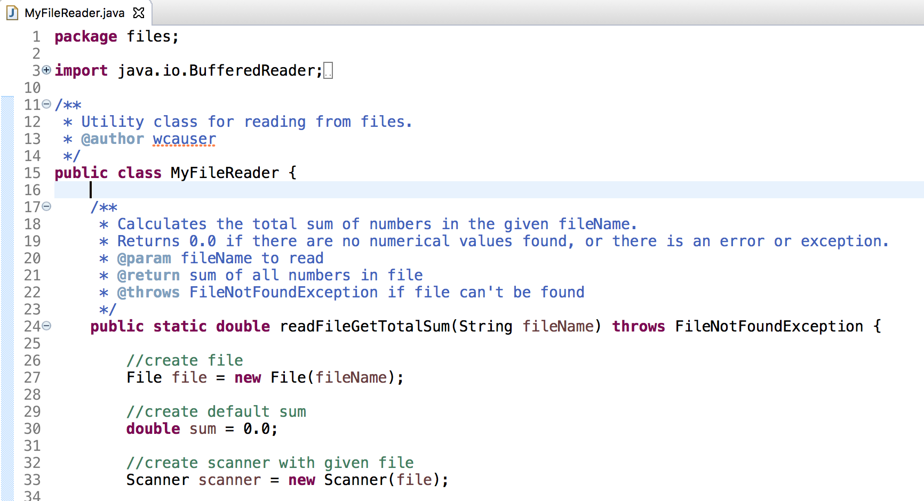
MyFileReader Class

Slide 35
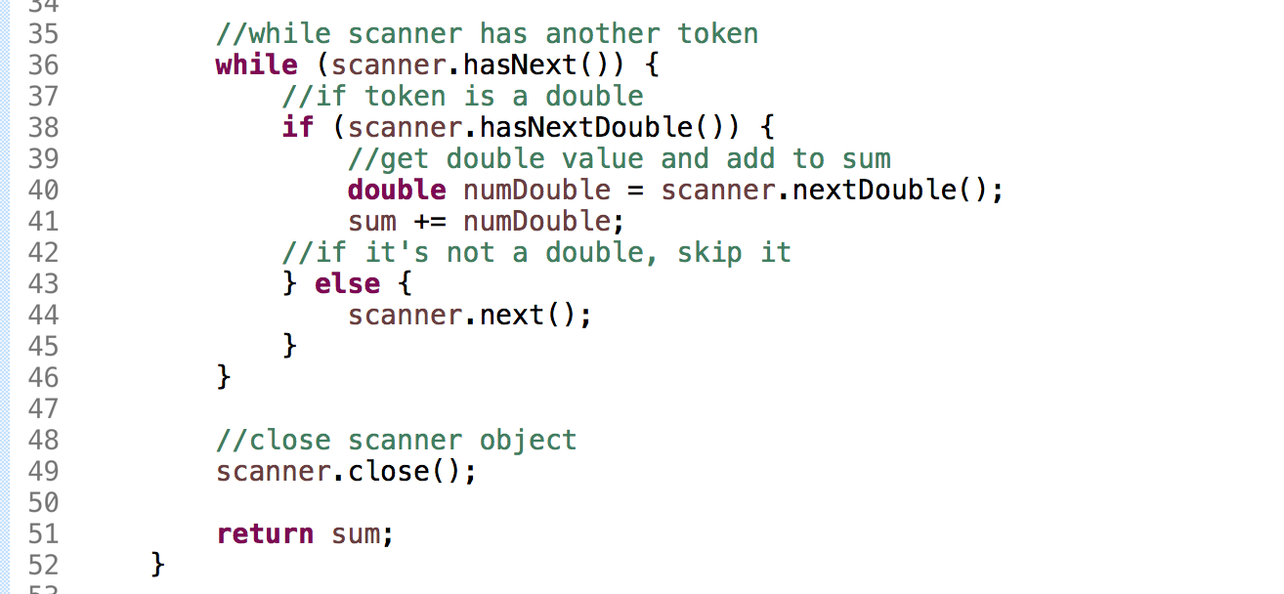
MyFileReader Class

Slide 36
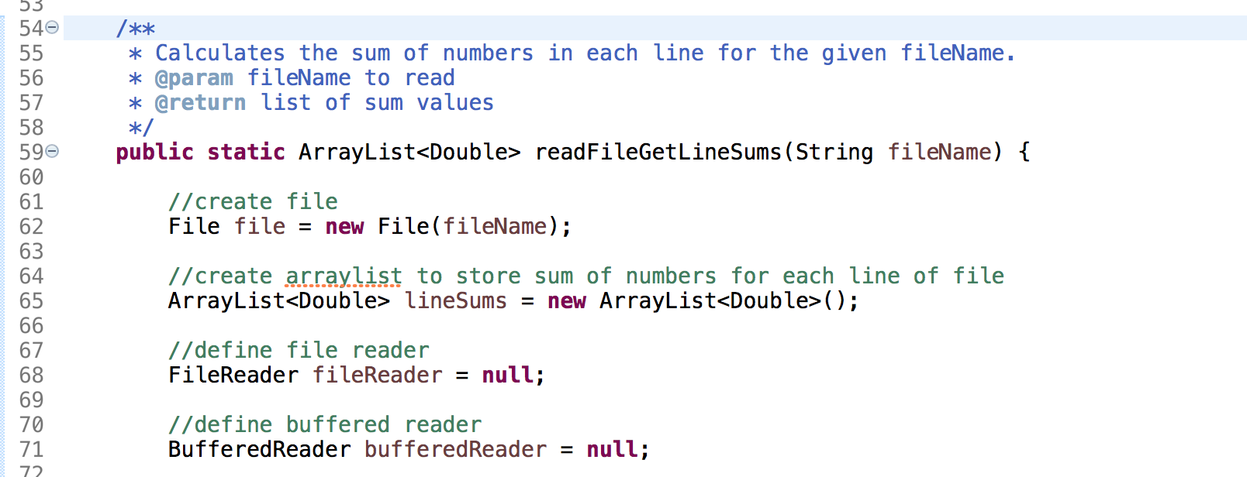
MyFileReader Class

Slide 37
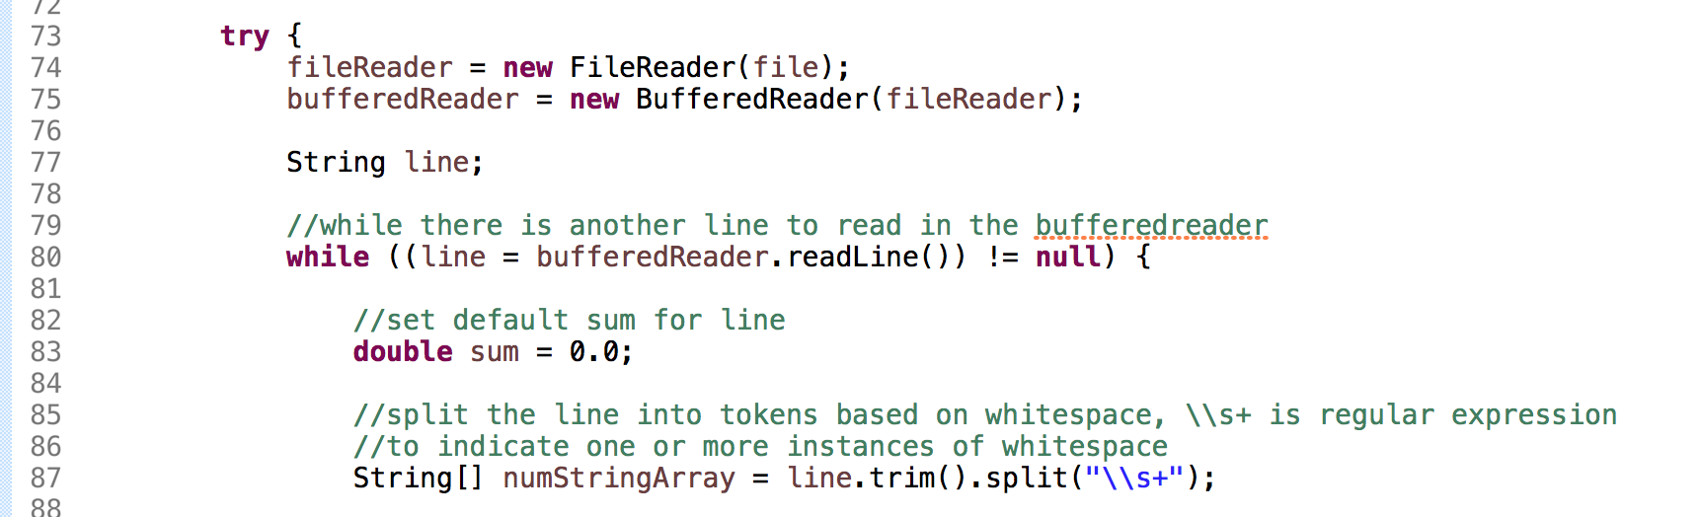
MyFileReader Class

Slide 38
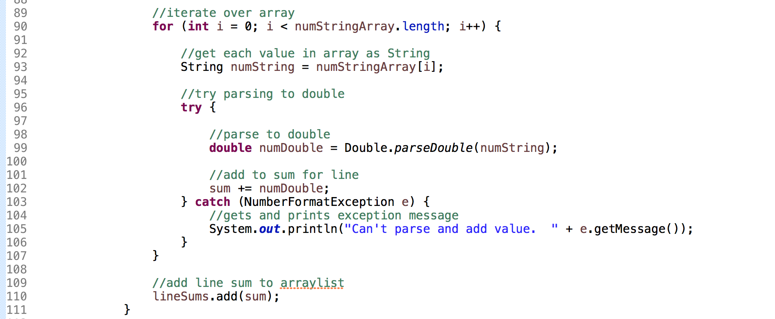
MyFileReader Class

Slide 39
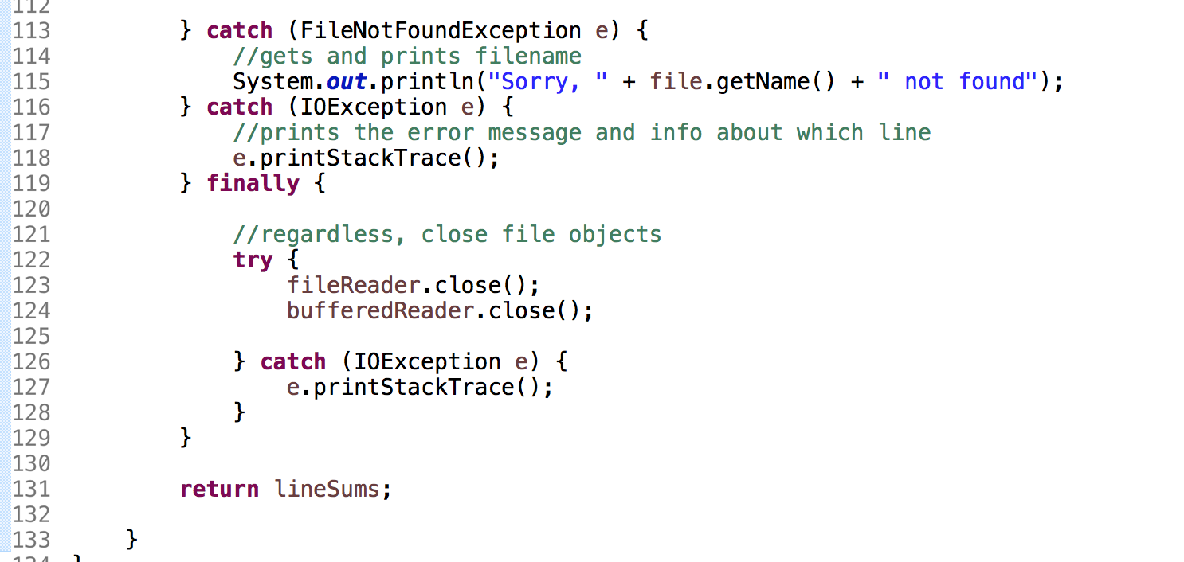
MyFileReader Class

Slide 40
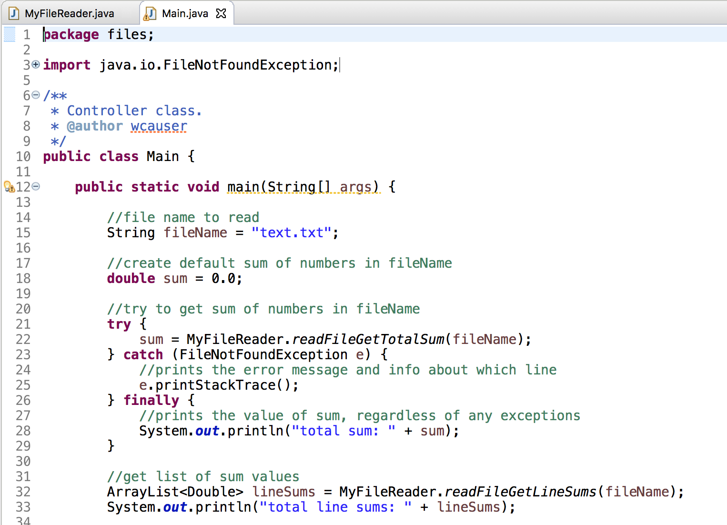
Main Class

Slide 41
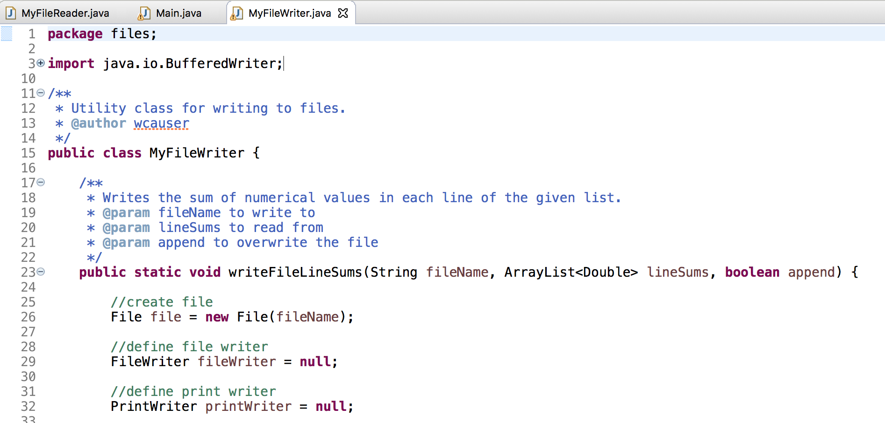
MyFileWriter Class

Slide 42
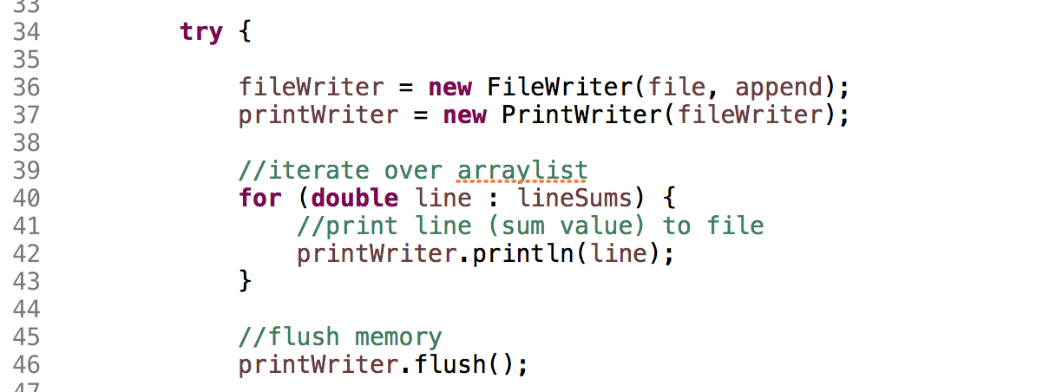
MyFileWriter Class

Slide 43
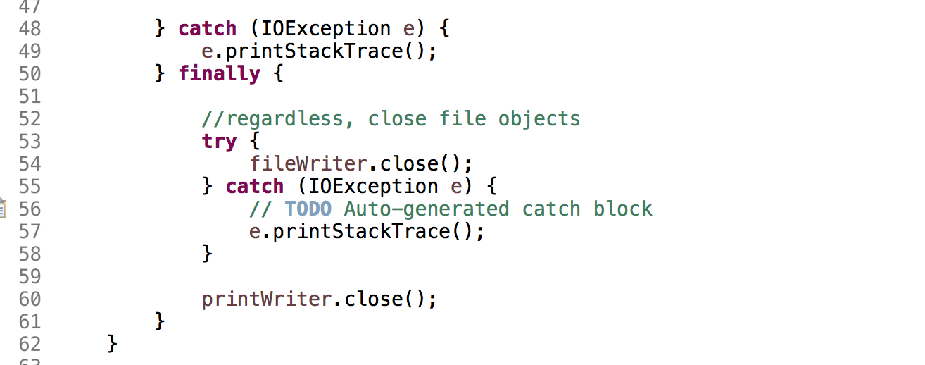
MyFileWriter Class

Slide 44
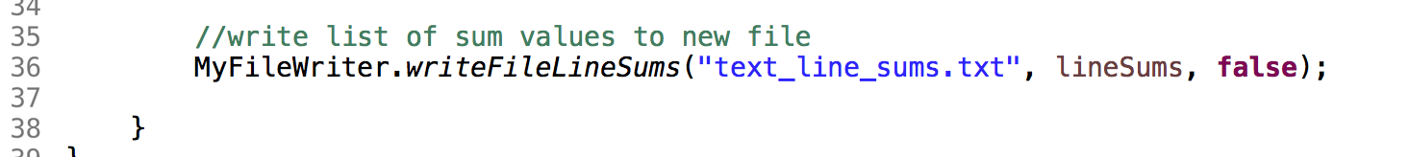
Main Class

